Slide 1
Nonprofit Compensation: Risks, Rules and Best Practices
Gregory W. Sampson, Esq.
Jennifer L. Gurevitz, Esq.
Gray Reed & McGraw, P.C.
1601 Elm Street Suite 4600
Dallas, Texas 75201
Nonprofit Law Study Group
Wednesday, April 16th, 2014

Slide 2
Overview
The Inurement/Impermissible Private Benefit Issue and Penalties
Determining Reasonable Compensation-§ 162
§162 criteria for deductible compensation
Forms of Compensation
Benefits and Contingent Compensation Issues
Safe Harbor for Compensation Decisions
Guides for Determining Reasonable Compensation

Slide 3
Issue: Inurement/Impermissible Private Benefit
IRC 501(c)(3) prohibits inurement of the net income of an organization to any private shareholder or individual.
Reg. 1.501(c)(3)-1(c)(2) states that an organization is not operated exclusively for one or more exempt purposes if its net earnings inure in whole or in part to the benefit of private individuals.
Reg. 1.501(a)-1(c) provides the definition of "private shareholder or individual: "having a personal and private interest in the activities of the organization.“
Reasonable Compensation is not inurement.

Slide 4
Private Inurement Penalties
Revocation of Tax Exempt Status
Excise Taxes under § 4958 Excess Benefit Rules:
Requirement to Return Excess Compensation
25% tax on Recipient (disqualified person under § 4958(f)(i))
200% tax if not corrected (returned) before end of the “taxable period.”
10% on tax officer, director or trustee who knowingly participated in paying excessive compensation.
Exception if not willful or done with reasonable cause
Public perception problems
990 Reporting
Media
General Distrust

Slide 5
IRS Criteria for Reasonableness
IRS Criteria for Reasonableness
Two Part Test for Reasonableness
Amount of compensation – reasonableness of total paid
Purpose – examines the services performed for compensation paid
Importance of Arms Length Negotiation (avoidance of related party involve)
Pay in comparable organizations:
Size
Mission
Geography
Executives’ experience and credentials
Executive and organization performance
Existing contracts/Salary History

Slide 6
IRC 162 Factors: Reasonable Comp.
The Employee:
1) the nature of the employee's duties;
2) the employee's background and experience;
3) the employee's knowledge of the business;
The Job:
4) the size of the business;
5) the employee's contribution to the profit making;
6) the time devoted by the employee to the business;
7) the character and amount of responsibility of the employee;

Slide 7
IRC 162 Factors: Reasonable Comp. - Cont.
Other Factors:
8) the economic conditions in general and locally;
9) the time of year when compensation is determined;
10) the amount paid by similar size businesses in the same area to equally qualified employees for similar services;
Primarily For Profit Factors:
11) the relationship of shareholder-officer's compensation to stock holdings;
12) whether alleged compensation is in reality, in whole or in part, payment for a business or assets acquired

Slide 8
What is Compensation?
Wage/Salary
Fringe benefits / perquisites
Severance
Nonqualified deferred compensation (e.g., I.R.C. § 457(f) plans)
Other special pay arrangements:
◦ Equity based-pay
◦ Pay based on gross revenue or net earnings
◦ Initial contract payments

Slide 9
Issues with Benefits/Perquisites
Excess Benefit: An excess benefit is any kind of transaction in which an insider receives an economic benefit from an exempt organization that exceeds the fair market value of what the organization receives in return.
Collect compensation from the organization that exceeds the fair value of the services rendered.
Buy property from the organization at less than fair value or sell property to the organization at greater than fair value.
Lease property from the organization at less than fair value or lease property to the organization at greater than fair value.
Borrow money from the organization on less than fair value terms or lend money to the organization on greater than fair value terms.
Engage in one of the above transactions with an entity controlled by the organization.

Slide 10
Excess Benefit Examples
President's compensation. A board member is on the committee that approves the compensation of the organization's new president. The board member knows that the fair-market value of the president's services does not exceed $150,000. Nevertheless, the board member votes to approve setting the president's compensation at $250,000.
Legal services. A board member who is an attorney performs legal services for the organization. During the year, the attorney bills the organization $100,000 for legal services. It is later determined that the fair market value of those services was $50,000.
Lease. A board member rents office space from the organization for $100,000 per year. It is later determined that fair rental value is $200,000 per year.
Purchase from related party. A board member owns more than 35 percent of an office supply corporation. The corporation has a contract to supply all of the organization's paper needs. During the year the corporation charges the organization $100,000 for paper, but it is later determined that the fair market value of the paper is $50,000.

Slide 11
Excess Benefits: Exclusions
Disregarded economic benefits:
Nontaxable fringe benefits;
Expense reimbursements paid in accordance with an accountable plan (such as paying reasonable expenses for members of an organization's governing body to attend meetings).
Initial Contract Exception: Intermediate sanctions do not apply to a fixed payment for services or property made under a contract with a person who is not an insider with respect to the organization prior to entering into the contract.

Slide 12
Issues with Contingent Compensation
Reg. 1.162-7(b)(2) states that the form of compensation does not determine its appropriateness.
Generally speaking, if contingent compensation is paid pursuant to a free bargain between the employer and the individual made before the services are rendered, not influenced by any consideration on the part of the employer other than that of securing on fair and advantageous terms the services of the individual, it should be allowed as a deduction even though in the actual working out of the contract it may prove to be greater than the amount which would ordinarily be paid.

Slide 13
Application to Non-Profits
Although the cases involving exempt organizations do not expressly embrace the IRC 162 analysis of contingent compensation, the reasoning of the cases is quite similar.
Arms length conditions are important
% fees without caps are usually unreasonable
The focus is on whether the form of compensation serves a real and discernable business purpose for the exempt organization. It must relate to the organization’s mission.
One purpose contingent payments might serve is to relieve an organization of the need to maintain a large reserve to cover its risk of loss if a venture or project failed.

Slide 14
Examples on Contingent Comp.
Compensation Plan Approved:
A hospital's percentage-of-income arrangement for doctors. Rev. Rul. 69-383.
A percentage-of-savings incentive compensation plan for a broad class of non-management hospital employees. G.C.M. 39674.
Compensation Plan Rejected:
No ceiling on the total compensation possible. People of God Community v. Commissioner, 75 T.C. 127, 131 (1980);
A joint venture between the organization and the compensated party. Lorain Avenue Clinic v. Comm., 31 T.C. 141 (1958).

Slide 15
Rebuttable Presumption of Reasonableness (Safe Harbor)
Under section 53.4958-6 of the regulations, there is a “rebuttable presumption” that the transaction is at fair market value if:
1. The transaction must be approved in advance by disinterested members of the organization‘s governing body;
2. The governing body must obtain and rely on valid comparability data in approving the transaction; and
3. The governing body must contemporaneously document its decision and the reason for its decision.

Slide 16
IRS SAFE HARBOR
Approving compensation in advance; the board must ensure that no one who participates in the decision has a conflict of interest concerning the transaction.
Disinterested board of trustees/directors or separate compensation committee.
No more than 20 percent of the Compensation Committee or board are comprised of organization employees (avoid those who are compensated by the organization).
Other Relationships to avoid: Family, Business relationships (Affiliated groups).

Slide 17
Compensation Committee
Use independent persons without conflicts – avoid undue influence
Functions include:
Develop the process and policies for setting compensation and overall compensation strategy
Outline the compensation system and services of compensated positions
Conduct periodic performance reviews
Conduct Reasonableness studies and Document under the Safe-Harbor rules.

Slide 18
IRS SAFE HARBOR
Documenting the decision-making process:
“At the time” it approves the compensation: within later of the next meeting or 60 days after the agreement is finalized.
Should include the terms of the transaction and the date of its approval.
The members of the authorized body present during the debate and resulting vote on the transaction. Note all disinterested members.
The actions of any members of the authorized body having a conflict of interest.
The comparability data obtained and relied upon.
Documentation of the basis for the determination.

Slide 19
IRS SAFE HARBOR
Basing its decision on valid comparability data obtained before the compensation is approved.
Validity relates to reliability of source data and level of compatibility;
Smaller Entities:
Even organizations with gross receipts of less than $1 million should obtain comparables from three other organizations to be within the safe harbor;
Can use other organizations’ forms 990;
Need to Identify Similarity of Enterprise and Circumstances
Geographic Area;
Size;
Budget;
Mission;
Job description or Services.

Slide 20
IRS SAFE HARBOR
Larger Entities:
Entities with gross receipts exceeding $1 million should average in greater more documented efforts to determine reasonableness
Reliable Compensation data;
Services;
Enterprises – Similar in size, budget and mission;
Economic conditions;
Employee's duties and past performance history;
Amount of time the employee spends on the job;
Person’s compensation history;
Employee's background, skills, education, and experience whether the employee has actual written job offers from other organizations; and
How much other employees at the nonprofit are paid, and the availability of similar services in the nonprofit’s geographic area.

Slide 21
Common Compensation Surveys
GuideStar:
CEO Compensation Checkpoint
Nonprofit Compensation Report
Charity Navigator CEO Compensation Report
Inside NGO Compensation/Benefits Survey
Compensation Resources’ Surveys
Quatt Associates Surveys

Slide 22
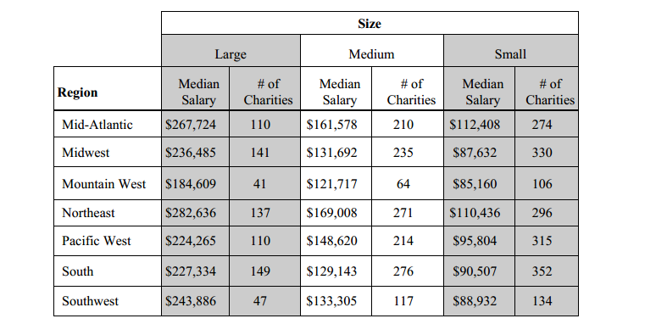
Charity Navigator Example: Size, Geography

Slide 23
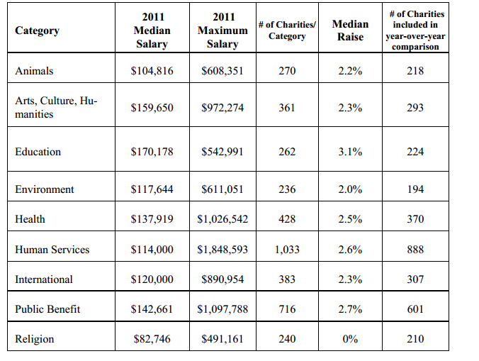
Charity Navigator: Mission/Category

