Slide 1
Keeping Your Trade Secrets Secret
Charles Sartain
Brooke Sizer
Gray Reed & McGraw
csartain@grayreed.com
bsizer@grayreed.com
www.energyandthelaw.com

Slide 2
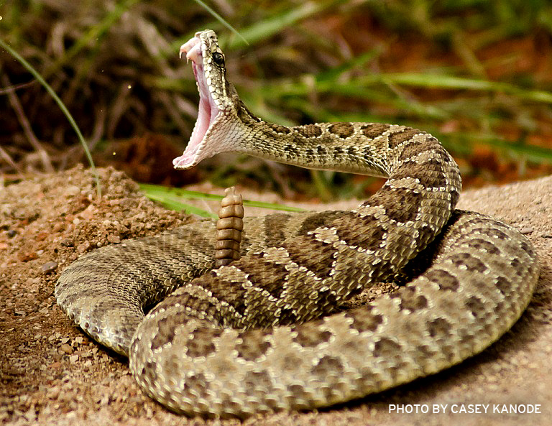
www.energyandthelaw.com

Slide 3
www.energyandthelaw.com

Slide 4
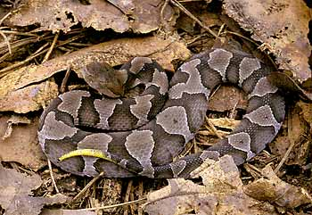
www.energyandthelaw.com

Slide 5
The Prospect Generator’s Nightmare
Southwestern Energy Production Company
vs.
Berry-Helfand and Muncey

Slide 6
Berry-Helfand and Muncey's Work
3.5 years
2.75 million acres, production from 453 wells, 187 porosity logs, 128 density neutron logs
Thousands of hours, cross-sections, structure maps, spreadsheets, dry holes, more data
10 sweet spots
www.energyandthelaw.com

Slide 7
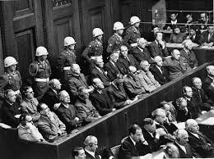
www.energyandthelaw.com

Slide 8
Berry-Helfand
80 successful James Lime wells.
100% success.
Revenues exceed $382M.
No paper trail.
No independent research.
Activity corresponds directly with sweet spots.
www.energyandthelaw.com

Slide 9
Damages
Courts can be “flexible and imaginative”.
Value of plaintiff’s lost profits,
Defendant’s actual profits,
Value a reasonably prudent investor would have paid,
Development costs avoided,
“Reasonable royalty”.
www.energyandthelaw.com

Slide 10
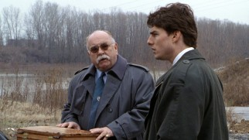

Slide 11
The Firm
Bill DeVasher: He ought to be kept on a short leash.
Avery Tolar: Why? You've got nothing to be suspicious about.
DeVasher: I get paid to be suspicious when I've got nothing to be suspicious about.

Slide 12
The Treasure Map and the Departing Shareholder
Lamont, et al
v.
Vaquillas Energy Lopeno Ltd, LLP et al

Slide 13
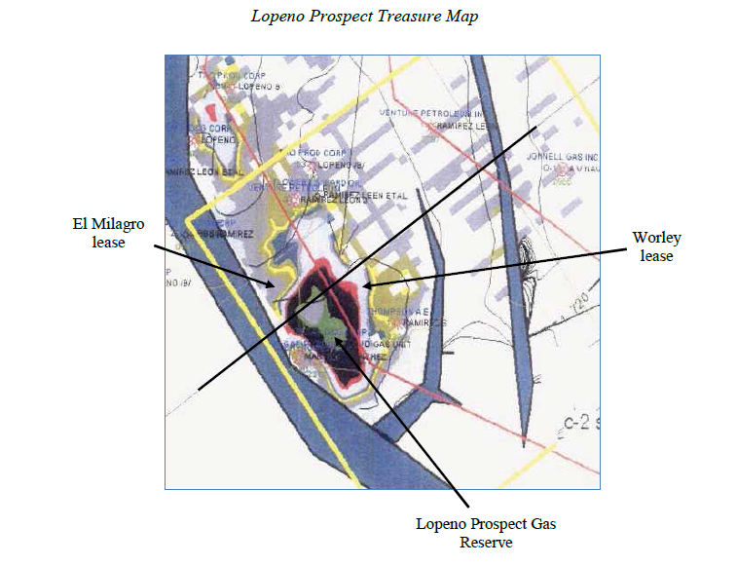
www.energyandthelaw.com

Slide 14
www.energyandthelaw.com

Slide 15
Vaquillas / Hamblin Lamont / Carranco
Ricochet
Vaquillas
Worley
Tract
Hamblin
Lamont
www.energyandthelaw.com

Slide 16
Vaquillas / Hamblin Lamont / Carranco
Vaquillas
Ricochet
Worley
Tract
Hamblin
Lamont
Montecristo
El Milagro Tract
Carranco
www.energyandthelaw.com

Slide 17
Timeline
Prospect ID’d
Treasure Map
P G A
Worley Lease
Lamont & Carranco Meet
Worley well log
8-12/06
03/07
09/04
Lamont/Ricochet Separation Agreement
JOA
Montecristo leases
El Milagro
$1 MM
www.energyandthelaw.com

Slide 18
Lamont
Lamont and Carranco lease El Milagro.
“The well-log made me do it”.
Oh yeah? The log only provided information on the Worley well.
No seismic data on El Milagro.
Letter to bank.
www.energyandthelaw.com

Slide 19
Texas Uniform Trade Secrets Act
Injunctive relief for threatened misappropriation.
Inevitable disclosure doctrine
Expanded definition of trade secret
Easier protective and sealing orders
www.energyandthelaw.com

Slide 20
Texas Uniform Trade Secrets Act
Attorneys’ fees to both the plaintiff and defendant;
Exemplary damages (not to exceed twice the economic damages)
Willful or malicious misappropriation.
Clear and convincing evidence.
www.energyandthelaw.com

Slide 21
Thank You
Charles Sartain
Brooke Sizer
Gray Reed & McGraw
csartain@grayreed.com
bsizer@grayreed.com
www.energyandthelaw.com

